Slide 1

Blockchain
Use Cases & Challenges for Healthcare
September 15, 2017

Slide 2
A distributed and immutable record of digital events
Blockchain is a suite of well understood technologies that have the potential to disrupt ways that countless industries track, verify and share transactional information.
MIT Professor Christian Catalini describes of blockchain at a high level as a technology that
  allows a network of computers
  to agree at regular intervals
  on the true state of a distributed ledger
Ledgers can contain different types of shared data
  transaction records,
  attributes of transactions,
  credentials, or
  other pieces of information

Slide 3
… So it’s a linked list where each entry contains a cryptographic hash of the previous entry.
Now for the Diagrams

Slide 4
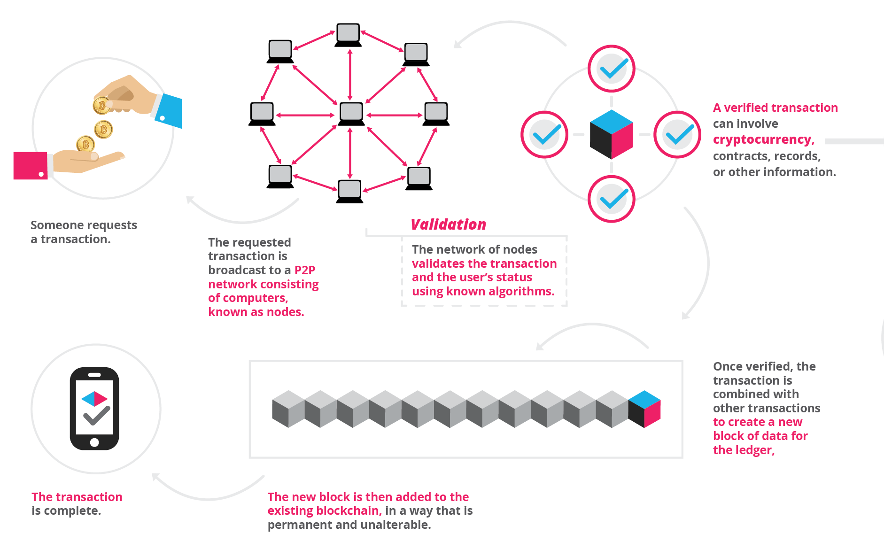

Slide 5

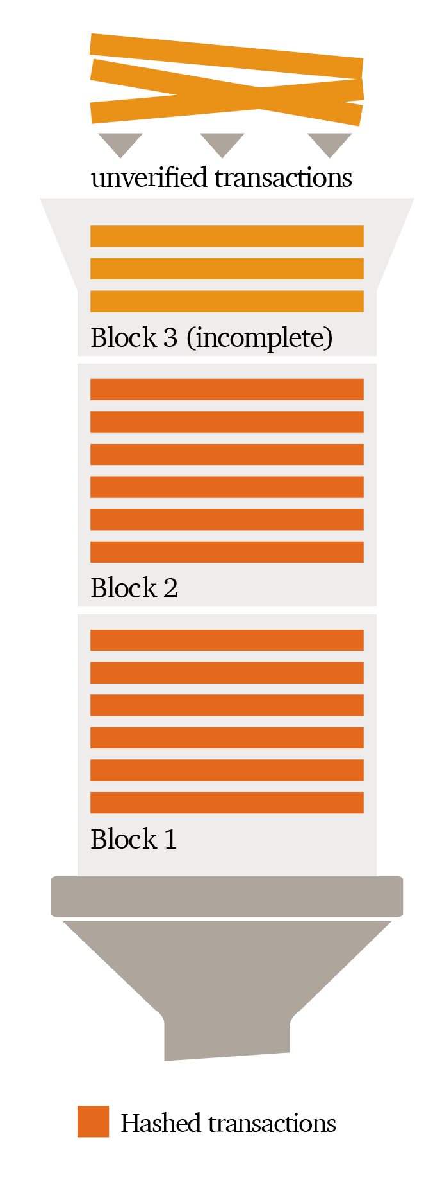
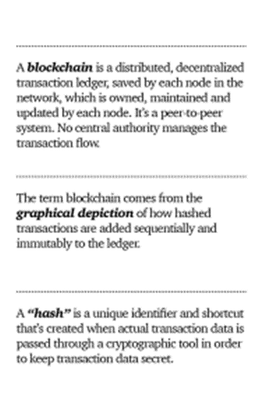
PWC – Blockchain Definition

Slide 6
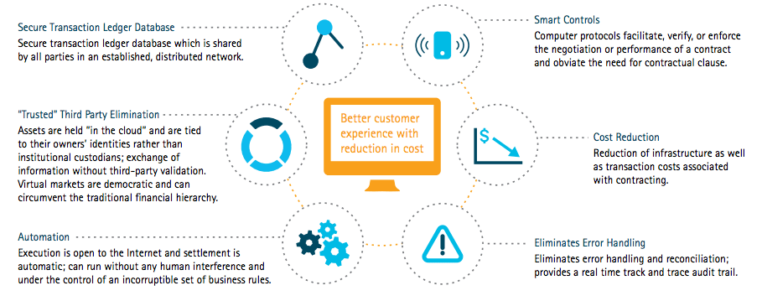
“Blockchain in the Investment Bank,” by Accenture

Slide 7
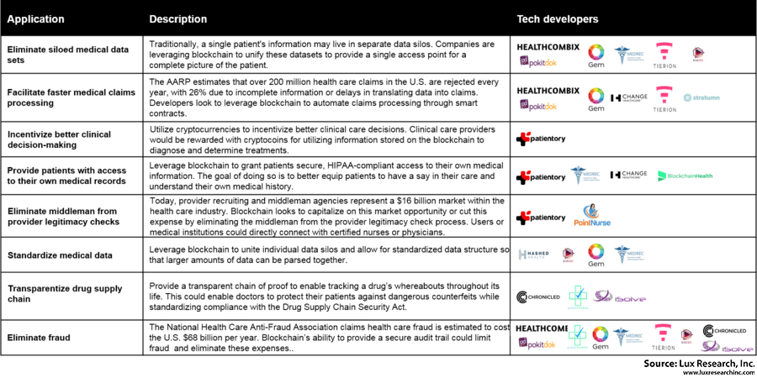

Use Cases

Slide 8
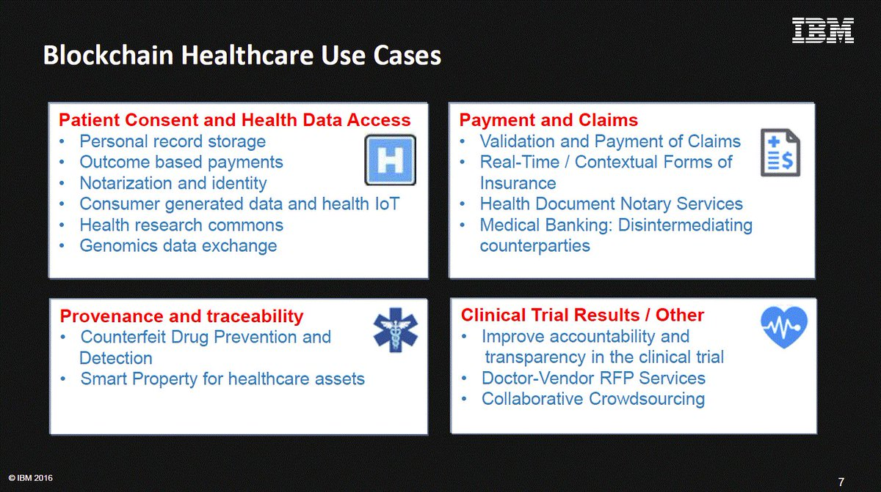

Slide 9
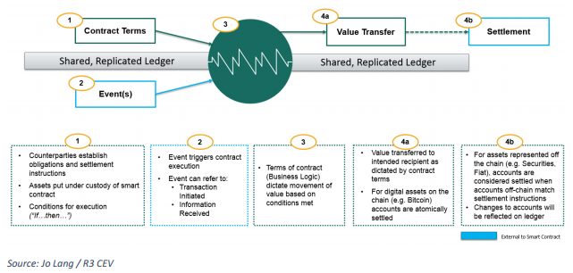
Smart Contracts

